Slide 1
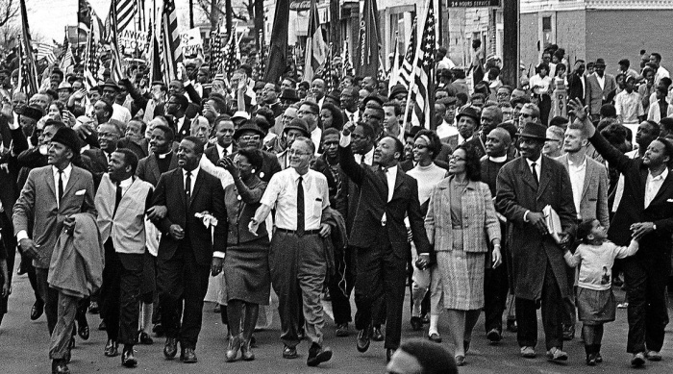
Conceptualizing Social Movements

Slide 2
Social Movements
Social movements are part of the social landscape
Most social issues have movements on one side or the other
Understanding society and social change requires understanding movements

Slide 3
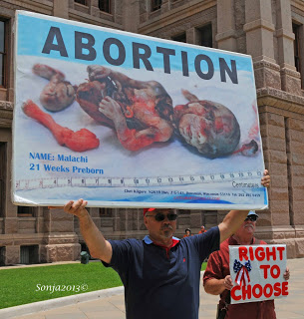
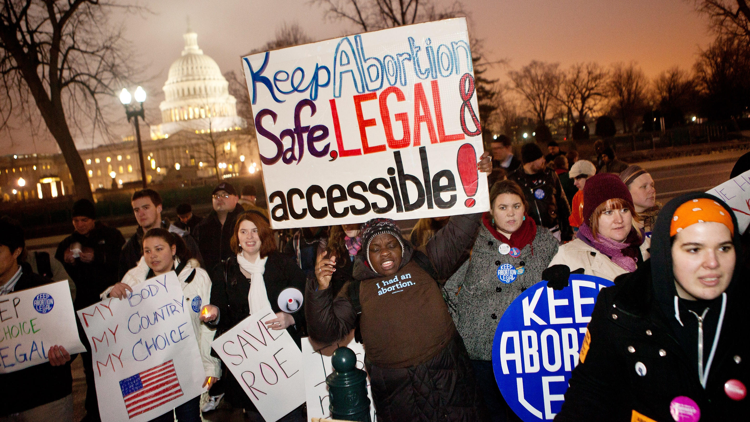
Women’s Health
Pro-Life
Pro-Choice

Slide 4
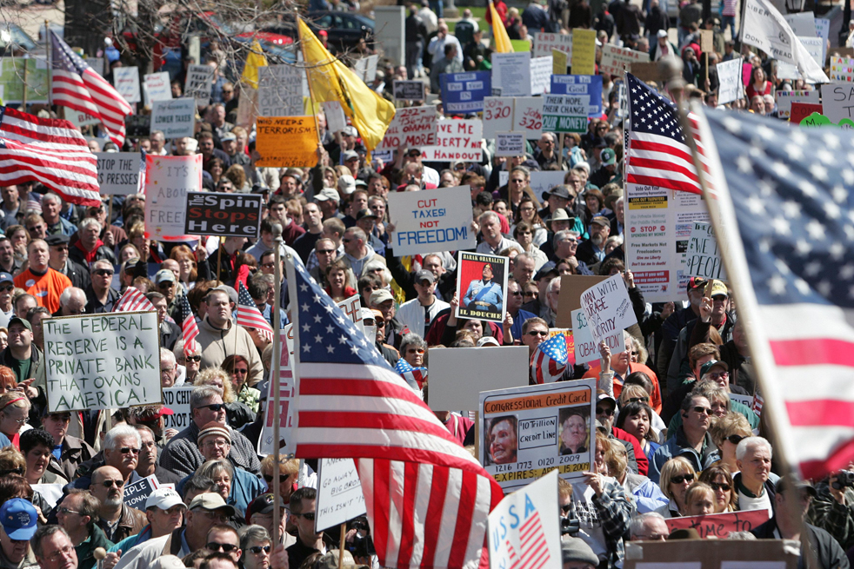
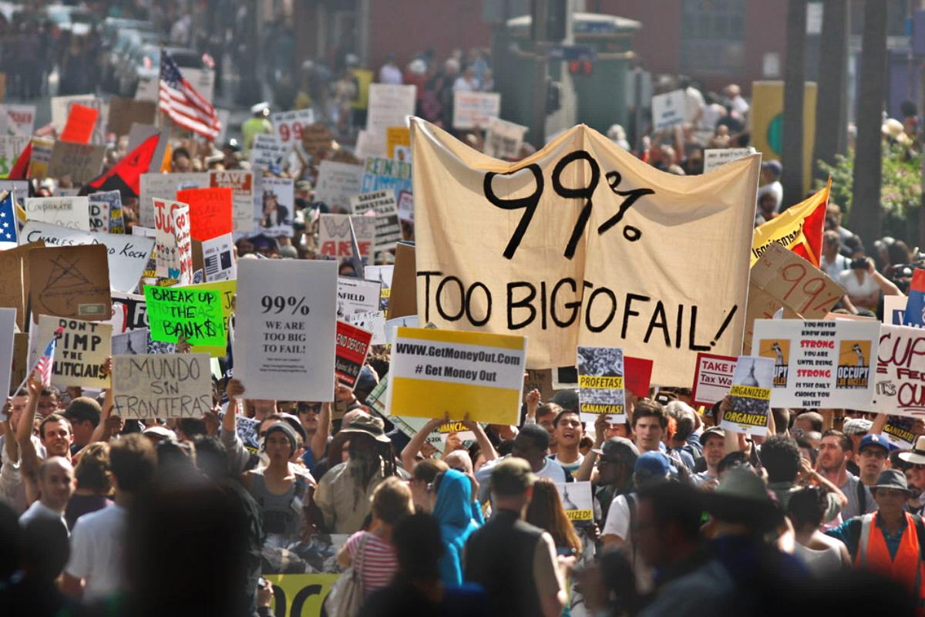
Income Inequality/Taxation
Tea Party
Occupy

Slide 5
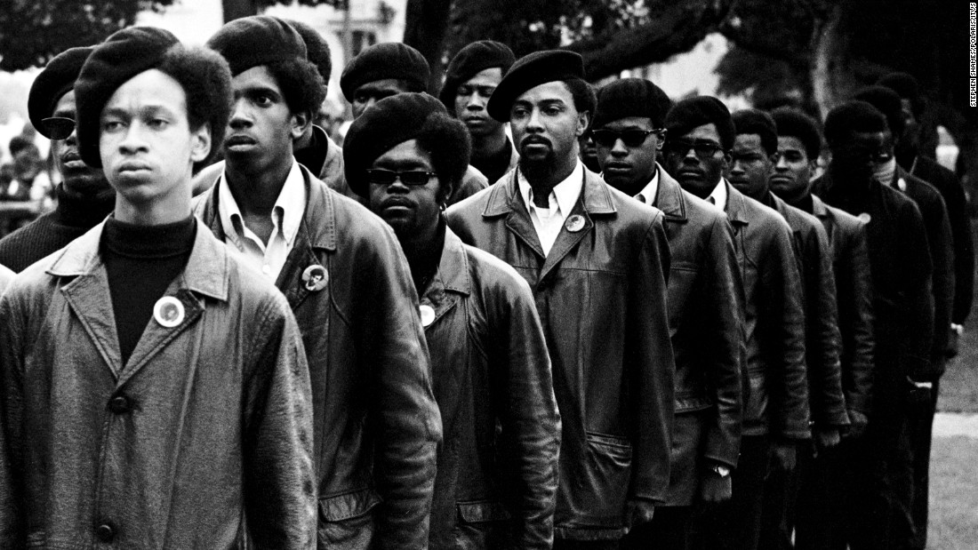
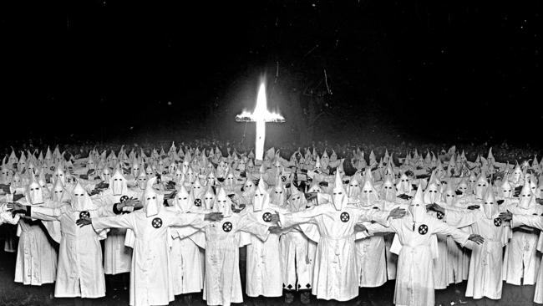
Race Relations
Civil Rights
Klan

Slide 6
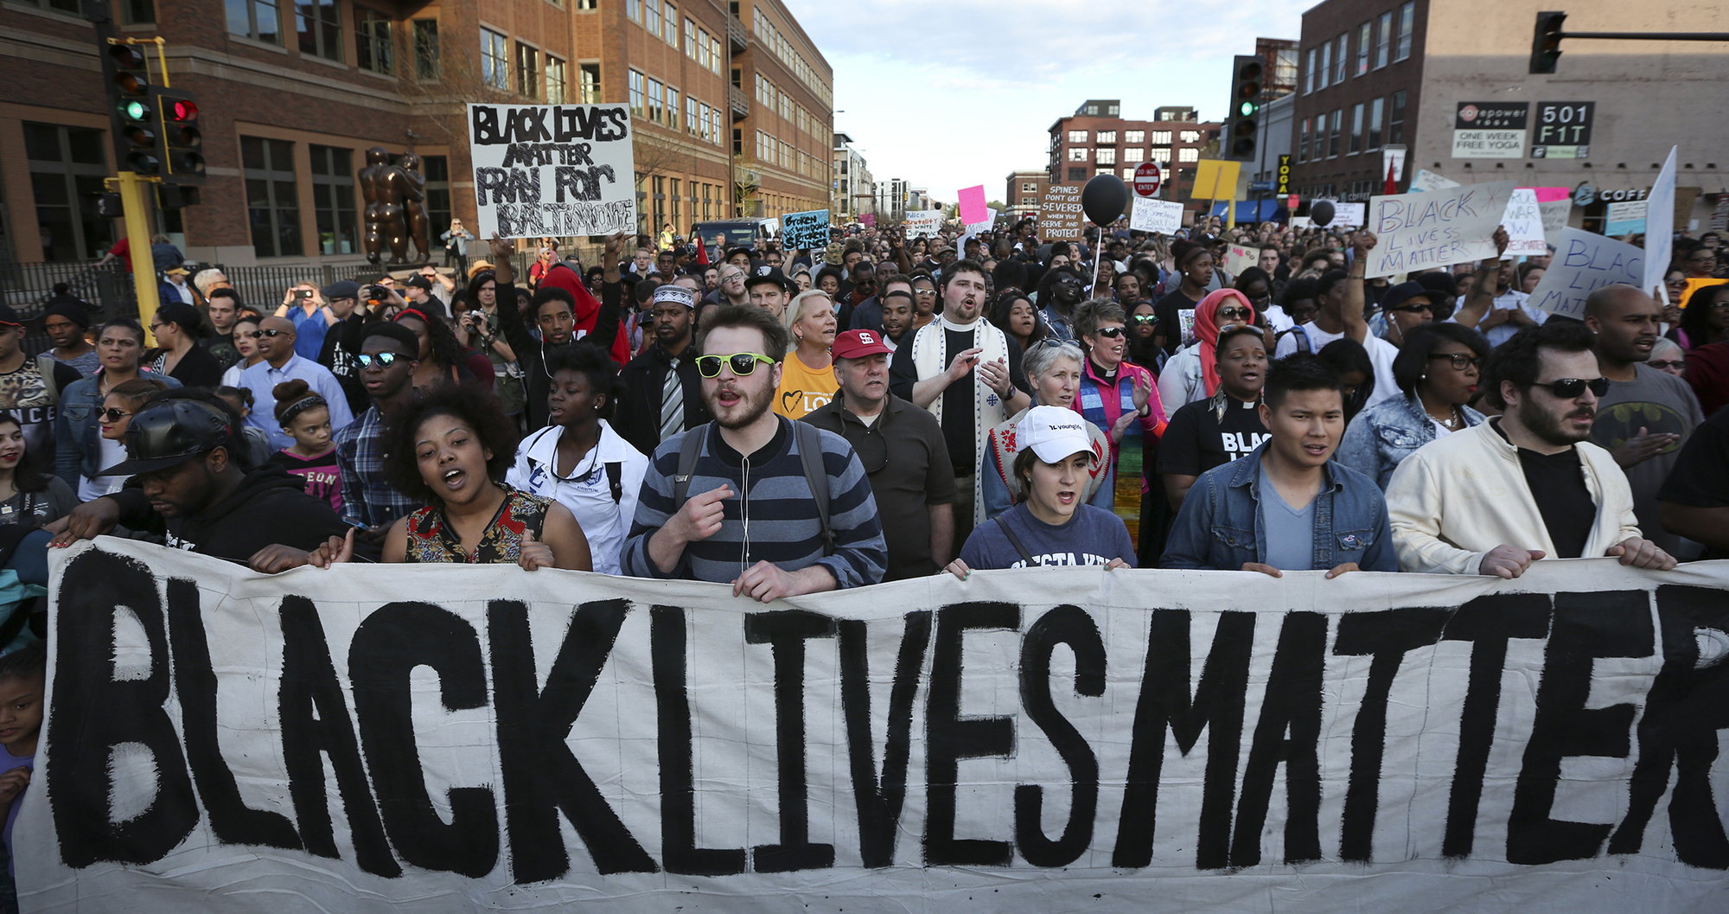
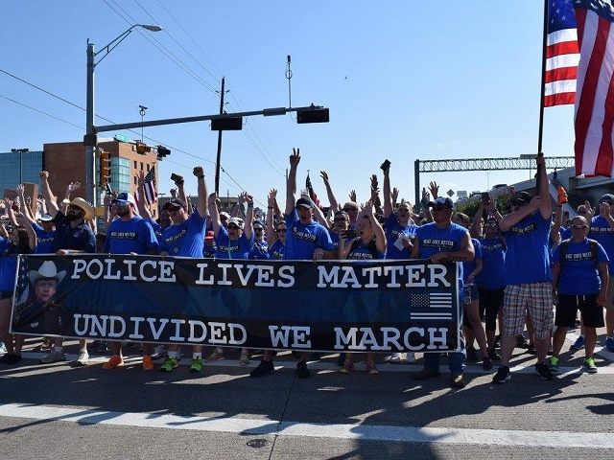
Race Relations Today
Black Lives
Blue Lives

Slide 7
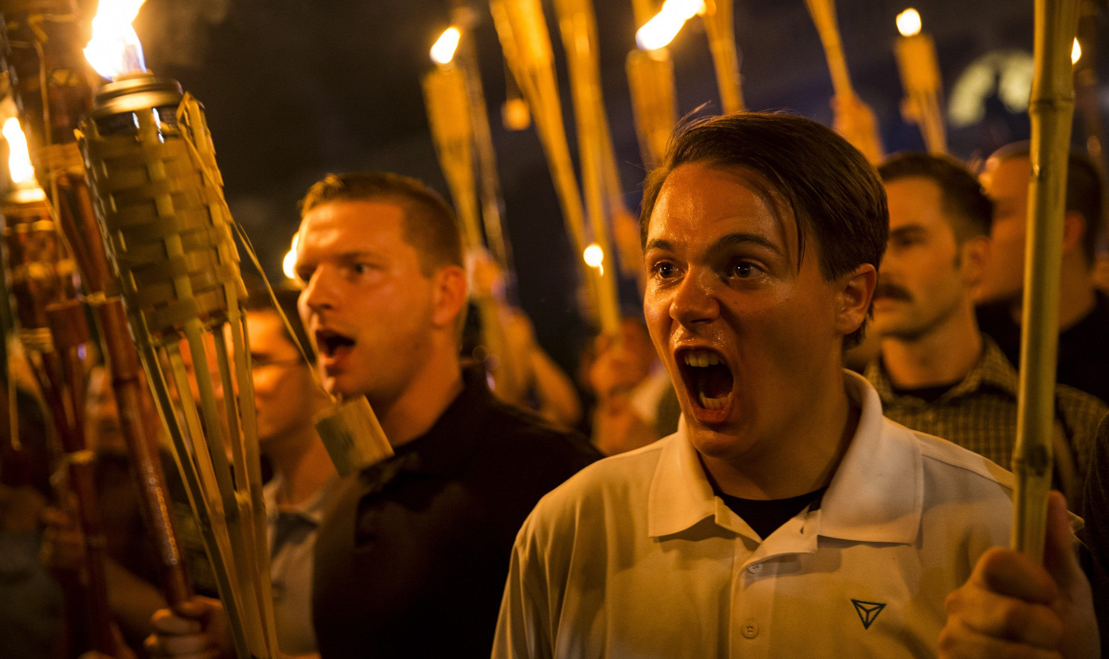
Race Relations Today (Last Week)
Black Lives
White Nationalists

Slide 8
Conceptualizing Movements
Social Movements (are):
Collective (rather than individual)
Challengers to or defenders of existing systems of authority, who
Operate with some degree of organization and
Continuity (e.g. they exist over time), and
Act, to varying degrees, outside of institutional arrangements

Slide 9
Social Movements as Collectivities
Involves some number of individuals, groups, or organizations engaged in action, pursued by two or more actors

Slide 10
Challengers to or Defenders of Systems of Authority
Challengers
systems of authority are typically the targets of social movement activity (social change)
Defenders
challengers are targets of activity (maintain status quo, reverse social change)
Notes:
Examples?

Slide 11
Systems of Authority
Political/Governmental
“the state” or national government, state houses, county seats, city hall, mayor’s office
Nongovernmental, for-profit
Nike, Texaco,
Nongovernmental, not-for-profit
CSUF, Stanford, Ford Foundation
Professional
APA, ASA
Religious denominations
Lutheran, Methodist
Cultural beliefs/understandings
Gender equality, distributive justice

Slide 12
Systems of Authority
Recognized power for making decisions, regulations, or guidelines that influence some aspect of life for individuals

Slide 13
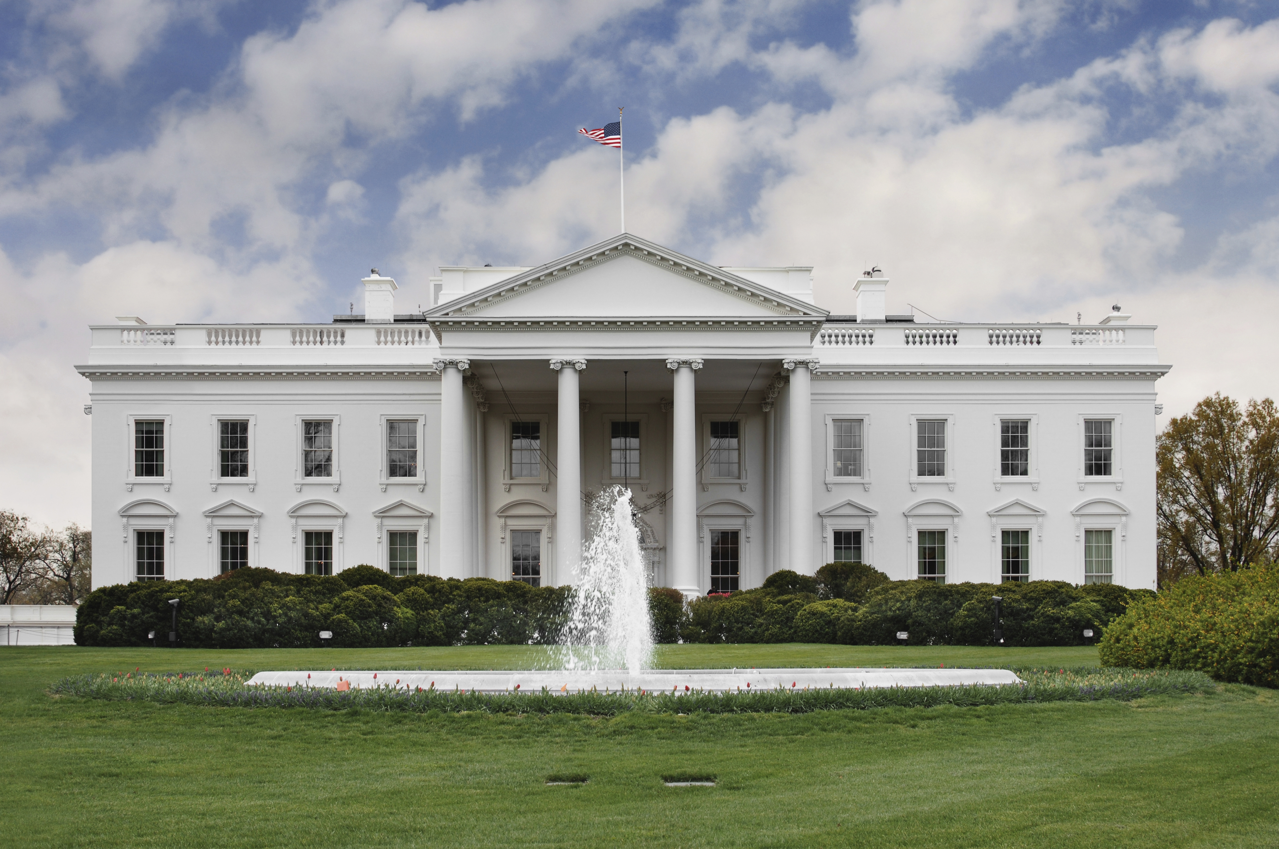
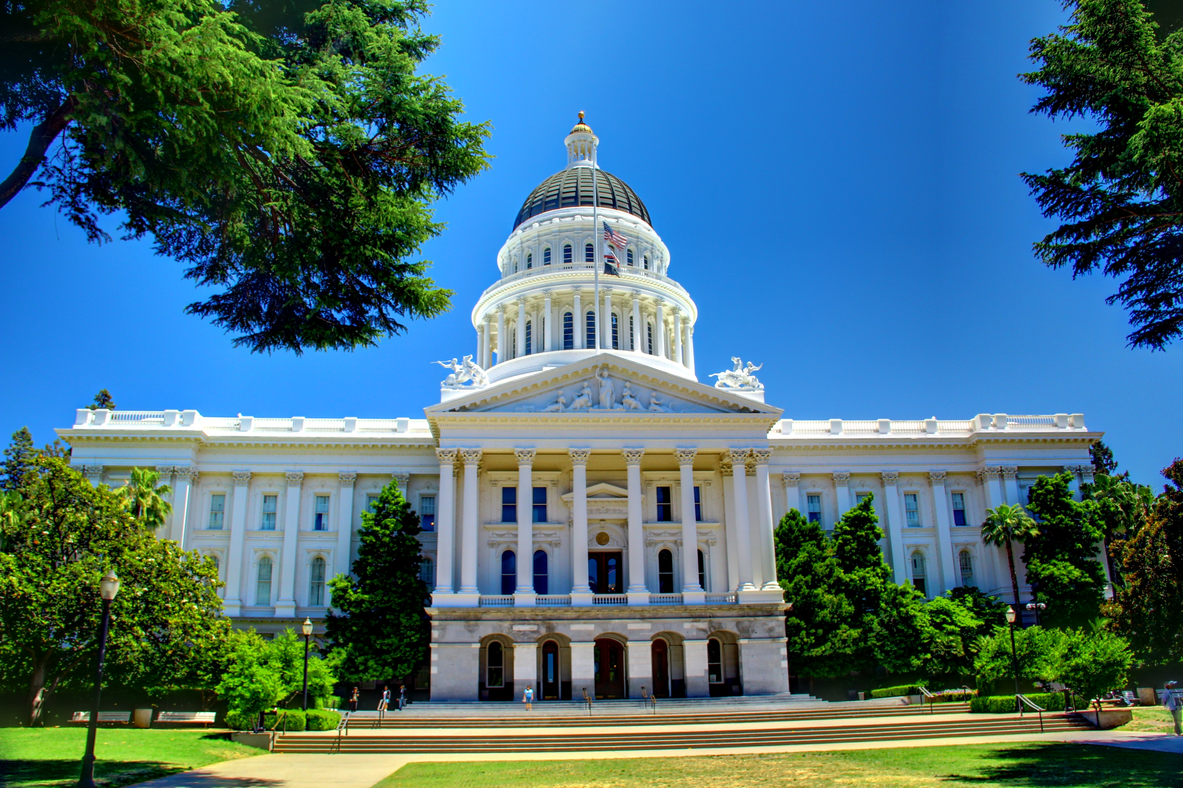
Systems of Authority
Recognized power for making decisions, regulations, or guidelines that influence some aspect of life for individuals

Slide 14

Systems of Authority
Recognized power for making decisions, regulations, or guidelines that influence some aspect of life for individuals

Slide 15


Systems of Authority
Recognized power for making decisions, regulations, or guidelines that influence some aspect of life for individuals

Slide 16

Systems of Authority
Recognized power for making decisions, regulations, or guidelines that influence some aspect of life for individuals

Slide 17
Organizations
Social movement action of any kind requires coordination, or organization
For movements, interests of a particular constituency are represented and promoted by one or more individuals associated with one or more organization (SMO)

Slide 18












Organizations

Slide 19
Social Movements as Extra-Institutional Actors
The challenges mounted by social movements are conducted outside institutional channels.
Interest groups:
Embedded in the system of authority, regarded as legitimate
Social movements:
Outside the system of authority, activists may distrust system

Slide 20
Interest Groups versus Social Movements
Interest groups
Pursue goals through institutionalized means, have access
Lobbying, direct access to policymakers
Social Movements
Pursue goals through extra-institutional means
Protest, rallies, sit-ins, boycotts, endorsements, new institutions

Slide 21
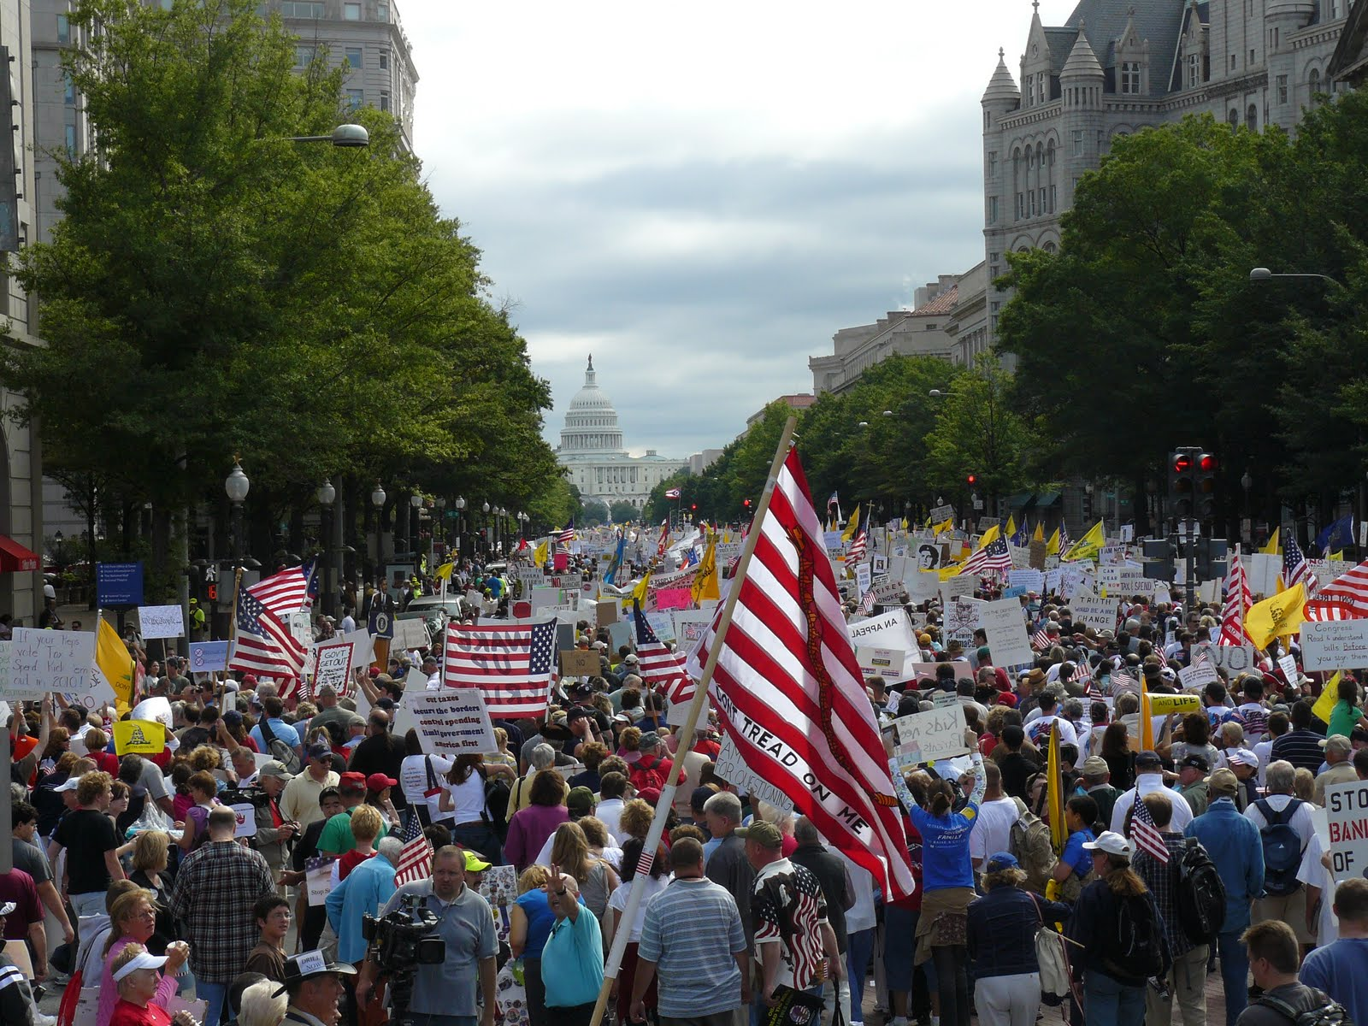
Not as Cut-and-Dry
Tea Party, 2009
Tea Party Protest (Social Movement)
Tea Party Caucus (Interest Group)

Slide 22
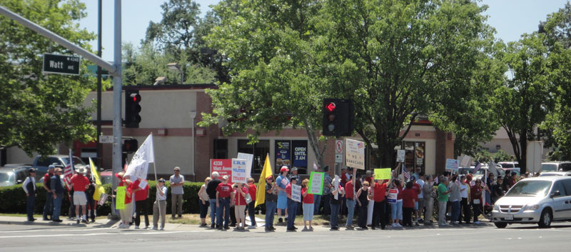
Not as Cut-and-Dry
Tea Party, 2011
Tea Party Protest (Social Movement)
Tea Party Caucus (Interest Group)

Slide 23
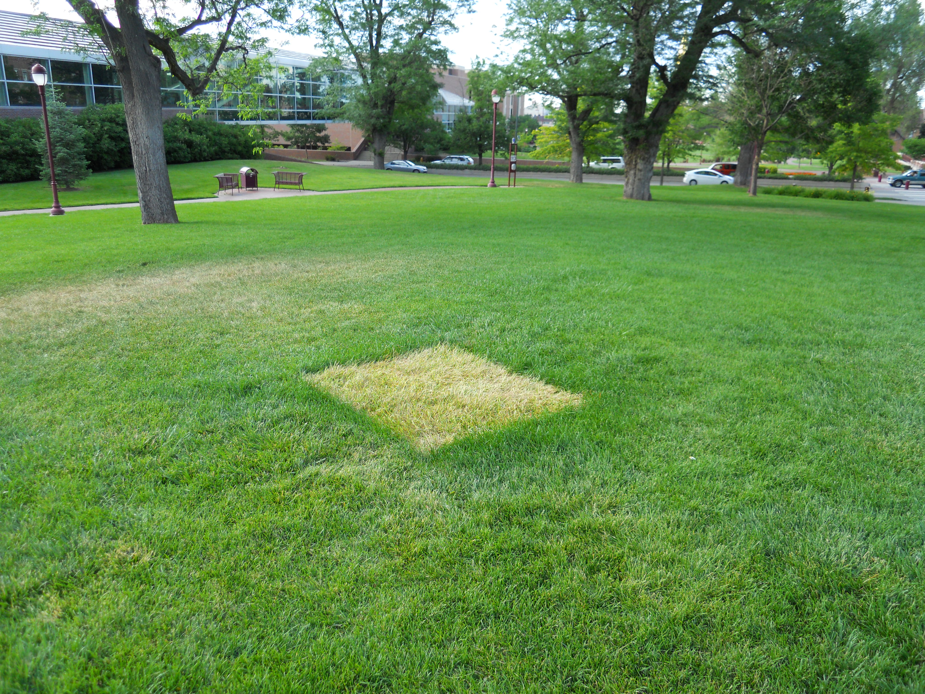
Not as Cut-and-Dry
Tea Party, 2013
Tea Party Protest (Social Movement)
Tea Party Caucus (Interest Group)

Slide 24
Continuity
Social movements relatively episodic phenomena, but not ephemeral
Meetings and protest aren’t regularly scheduled, but they also don’t appear/disappear
Can last for a few days, weeks, years, or decades
Activity can wax and wane over time
Activity must occur more than once

Slide 25
Questions Addressed through Social Movement Research
What grievances contribute to the emergence of social movements?
What contextual conditions prompt or inhibit the emergence of social movements?
What are the determinants of individual participation in social movement activity?
What strategies/tactics help social movements achieve their goals?
What are the consequences/outcomes of social movements?

